Slide 1

KINEMATICS more…
FISIKA DASAR 1

Slide 2
More complicated situations
Special Case
Summary
Overview
Adopted from MIT Course

Slide 3

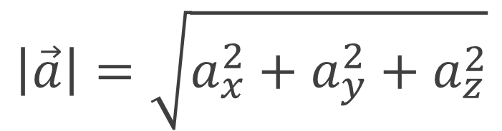
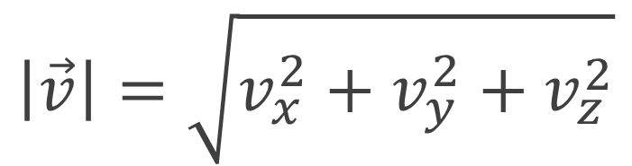
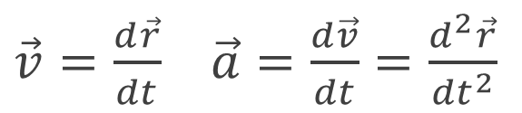
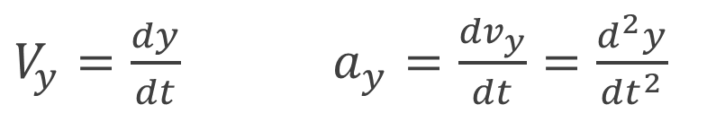
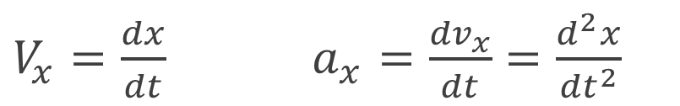
More complicated situations
Kinematics
Vector Connections
More Objects
Write an additional set of equations
More Dimensions
$\vec{v}=\frac{d\vec{r}}{dt}$ $\vec{a}=\frac{d\vec{v}}{dt}=\frac{d^{2}\vec{r}}{{dt}^{2}}$
Write an additional set of equations
$V_{x}=\frac{dx}{dt}$ $a_{x}=\frac{{dv}_{x}}{dt}=\frac{d^{2}x}{{dt}^{2}}$
$$\left|\vec{v}\right|=\sqrt{v_{x}^{2}+v_{y}^{2}+v_{z}^{2}}$$
Bring your business to the next Level with Powerfull presentation material for all business
$V_{y}=\frac{dy}{dt}$ $a_{y}=\frac{{dv}_{y}}{dt}=\frac{d^{2}y}{{dt}^{2}}$
$$\left|\vec{a}\right|=\sqrt{a_{x}^{2}+a_{y}^{2}+a_{z}^{2}}$$
Adopted from MIT Course

Slide 4
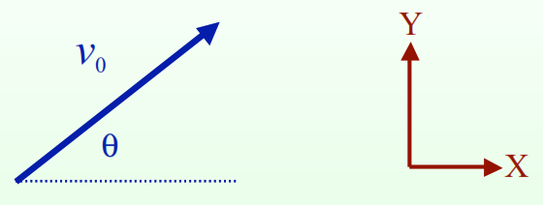
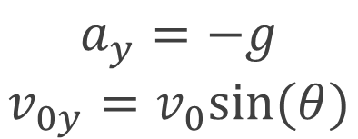
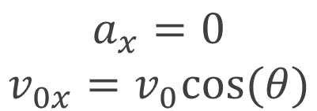
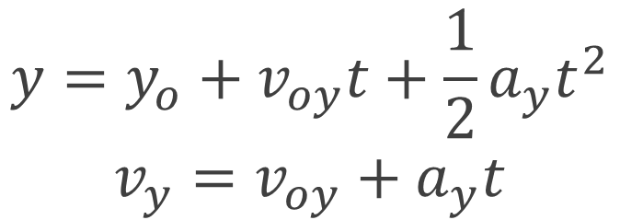
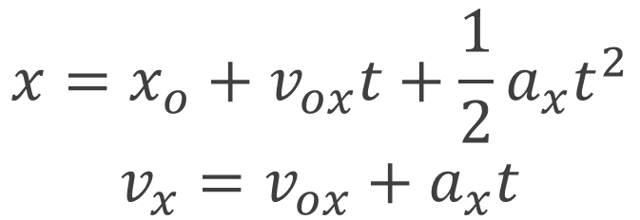
Special Case of Constant Acceleration
Extra Special Case
Kinematics
$$x=x_{o}+v_{ox}t+\frac{1}{2}a_{x}t^{2}$$
$$v_{x}=v_{ox}+a_{x}t$$
Trajectories with gravity near the surface of the Earth and no air resistance or other drag forces
$$y=y_{o}+v_{oy}t+\frac{1}{2}a_{y}t^{2}$$
$$v_{y}=v_{oy}+a_{y}t$$
$$a_{x}=0$$
$$v_{0x}=v_{0}cos⁡(θ)$$
$$a_{y}=−g$$
$$v_{0y}=v_{0}sin⁡(θ)$$
Initial conditions
Physics
Adopted from MIT Course

Slide 5
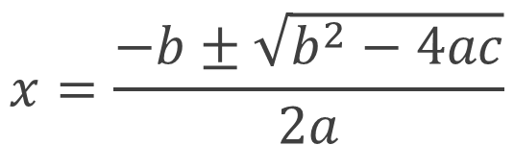

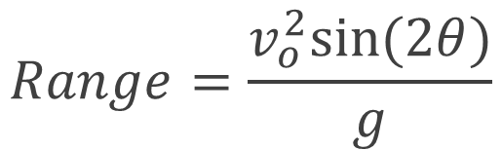
Super Special Case
Quadratic Equations
Range of a projectile near the surface of the Earth and no air resistance or other drag forces
$$ax^{2}+bx+c=0$$
$$x=\frac{−b±\sqrt{b^{2}−4ac}}{2a}$$
$x_{0}=0$ $y_{0}=0$ $y_{final}=0$ $x_{final}=Range$
Important property:
Such equations can have 0, 1, or 2 solutions depending on the value of b2-4ac.
Negative: 0 solutions Zero: 1 solution Positive: 2 solutions
$$Range=\frac{v_{o}^{2}sin⁡(2θ)}{g}$$
You should immediately forget you ever saw this formula but remember the technique used to find it.
Warning: Only one of the 2 solutions may be physical!
Adopted from MIT Course

Slide 6
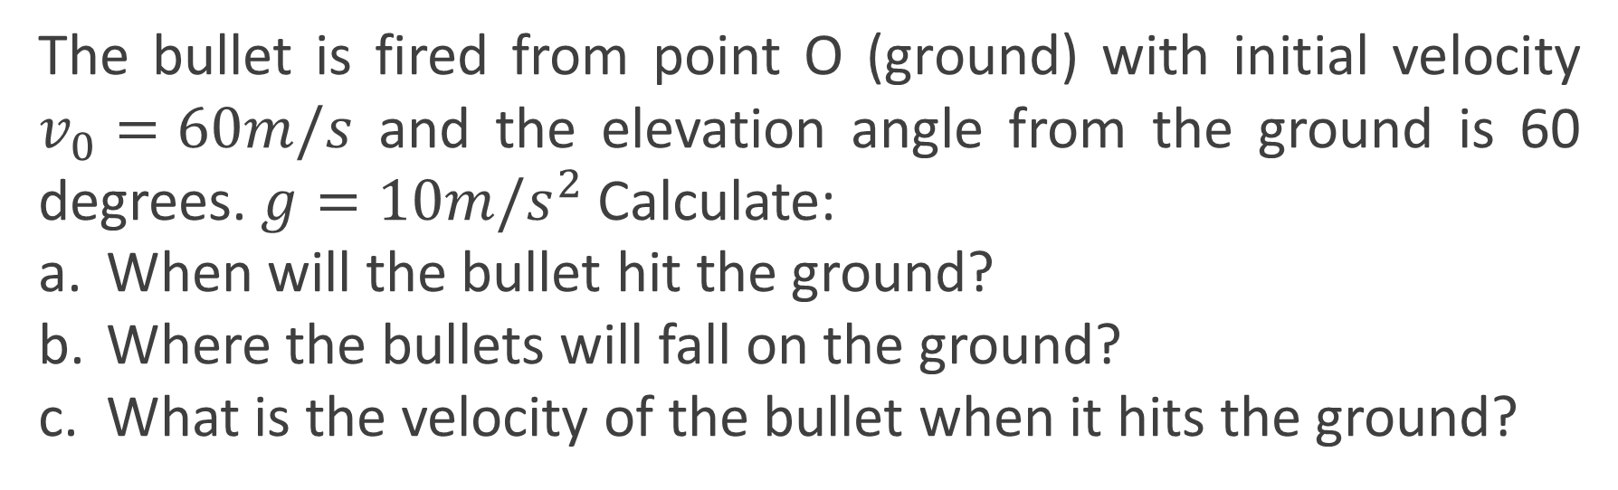
Example 1
Example
The bullet is fired from point O (ground) with initial velocity $v_{0}=60m/s$ and the elevation angle from the ground is 60 degrees. $g=10m/s^{2}$ Calculate:
When will the bullet hit the ground?
Where the bullets will fall on the ground?
What is the velocity of the bullet when it hits the ground?

Slide 7


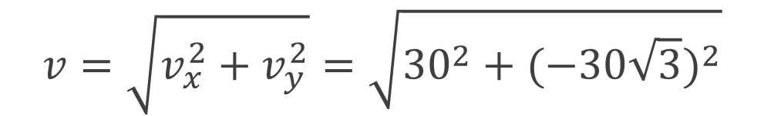







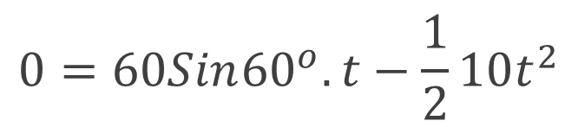

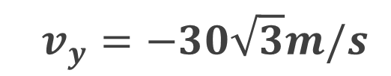

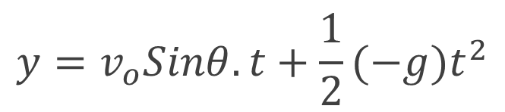
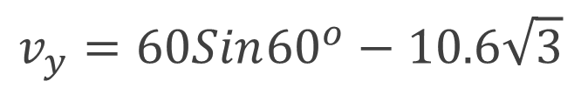
Example 1
Example
$$x=v_{o}cosθ.t$$
b.
$$x=60Sin{60}^{o}.6\sqrt{3}$$
Answer:
$$x=180\sqrt{3}m$$
a.
$y_{final}=0$
Bullet coordinates on the ground is ($180\sqrt{3},0)$
$$y=v_{o}Sinθ.t+\frac{1}{2}(−g{)t}^{2}$$
$$v_{y}=v_{o}Sinθ−gt$$
C.
$$v_{y}=60Sin{60}^{o}−10.6\sqrt{3}$$
$$0=60Sin{60}^{o}.t−\frac{1}{2}10t^{2}$$
$$v_{x}=v_{o}cosθ$$
$$v_{y}=−30\sqrt{3}m/s$$
$$v_{x}=60Sin{60}^{o}$$
$$0=30\sqrt{3}.t−5t^{2}$$
Exclusive Material
$$v_{x}=30m/s$$
$$t=6\sqrt{3}s$$
$$v=\sqrt{v_{x}^{2}+v_{y}^{2}}=\sqrt{{30}^{2}+{(−30\sqrt{3})}^{2}}$$
$$v=60m/s$$

Slide 8
SUMMARY
Study special cases (like range of a projectile) but understand the assumptions that go into all formulas
Position, velocity, and acceleration are ALL vectors and need to be manipulated using either arrows (qualitative) or components (quantitative)
Directions (or signs in 1D) of position, velocity, and acceleration can all be different
Adopted from MIT Course

Slide 9
THANK YOU

